Slide 1


CONTACT BOOK APPLICATION
HEMALATHA S

Slide 2



Aim of the project
Problem Statement
Project Description
Functionalities
Input Versatility with Error Handling & Exception Handling
Code Implementation
Result
Conclusion

Slide 3
The aim of the Contact Book Application project is to develop a user-friendly and efficient system for managing personal and professional contacts. The application seeks to streamline the process of adding, viewing, searching, updating, and deleting contact information while ensuring data validation and integrity. Additionally, the project aims to provide a reliable method for saving and loading contact data to and from a file, allowing users to maintain their contact information across sessions.
AIM OF THE PROJECT

Slide 4
PROBLEM STATEMENT
Manual Contact Management
Data Integrity Issues
Lack of Persistence
Need for Modernization
OVERVIEW OF THE PROJECT
Automated Contact Management
Enhanced Data Validation
User-Focused Design
Centralized Information Management

Slide 5
The Contact Book Application aims to develop a comprehensive contact management system to address existing challenges in maintaining personal and professional contacts. The project focuses on streamlining contact management processes, enhancing data validation, ensuring reliable data storage, and providing a user-focused design.
PROJECT DESCRIPTION

Slide 6
Programming Language: Python 3
Data Structures - Lists and Dictionaries: Used to store and manage contact data within the application.
Regular Expressions (re) - Email Validation: Implemented to ensure correct email formats for contact entries, enhancing data integrity.
File Handling - Text File Storage: Contacts are saved to and loaded from a text file (contacts.txt) for persistent storage and retrieval across application sessions.
Exception Handling - Custom Exceptions: Utilized to manage and provide informative error messages for invalid inputs, ensuring robust error handling throughout the application.
TECHNOLOGIES & METHODOLOGIES

Slide 7
Add Contact
View Contacts
Search Contact
Update Contact
Delete Contact
Save Contacts
Load Contacts
Exception Handling
User Interface
FUNCTIONALITIES

Slide 8
INPUT VERSATILITY WITH ERROR HANDLING & EXCEPTION HANDLING
Name Validation
Phone Number Validation
Email Validation
CODE IMPLEMENTATION
This implementation includes input versatility with error handling and exception handling to ensure data integrity and user-friendly interaction.

Slide 9
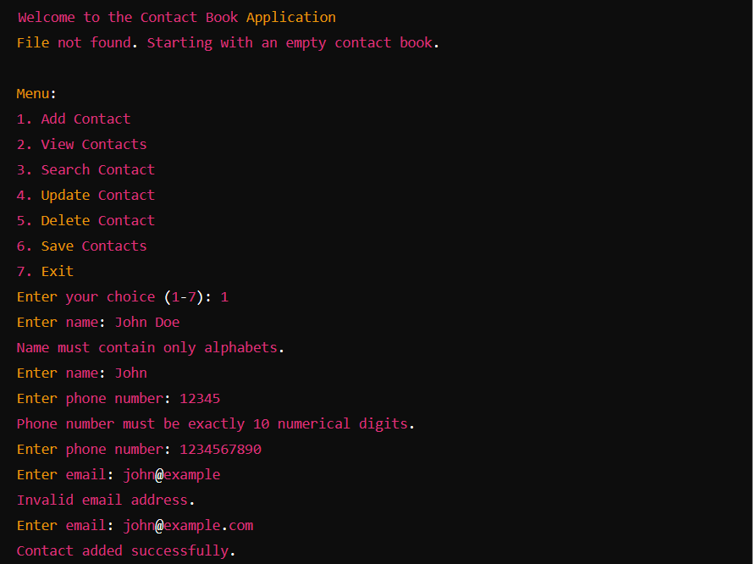
RESULT

Slide 10
The Contact Book Application project aims to streamline contact management tasks while prioritizing data integrity, user experience, and operational efficiency. By implementing robust input validation, error handling, and intuitive user interaction, the application provides a reliable solution for managing personal and professional contacts effectively.
CONCLUSION

Slide 11


